Slide 1
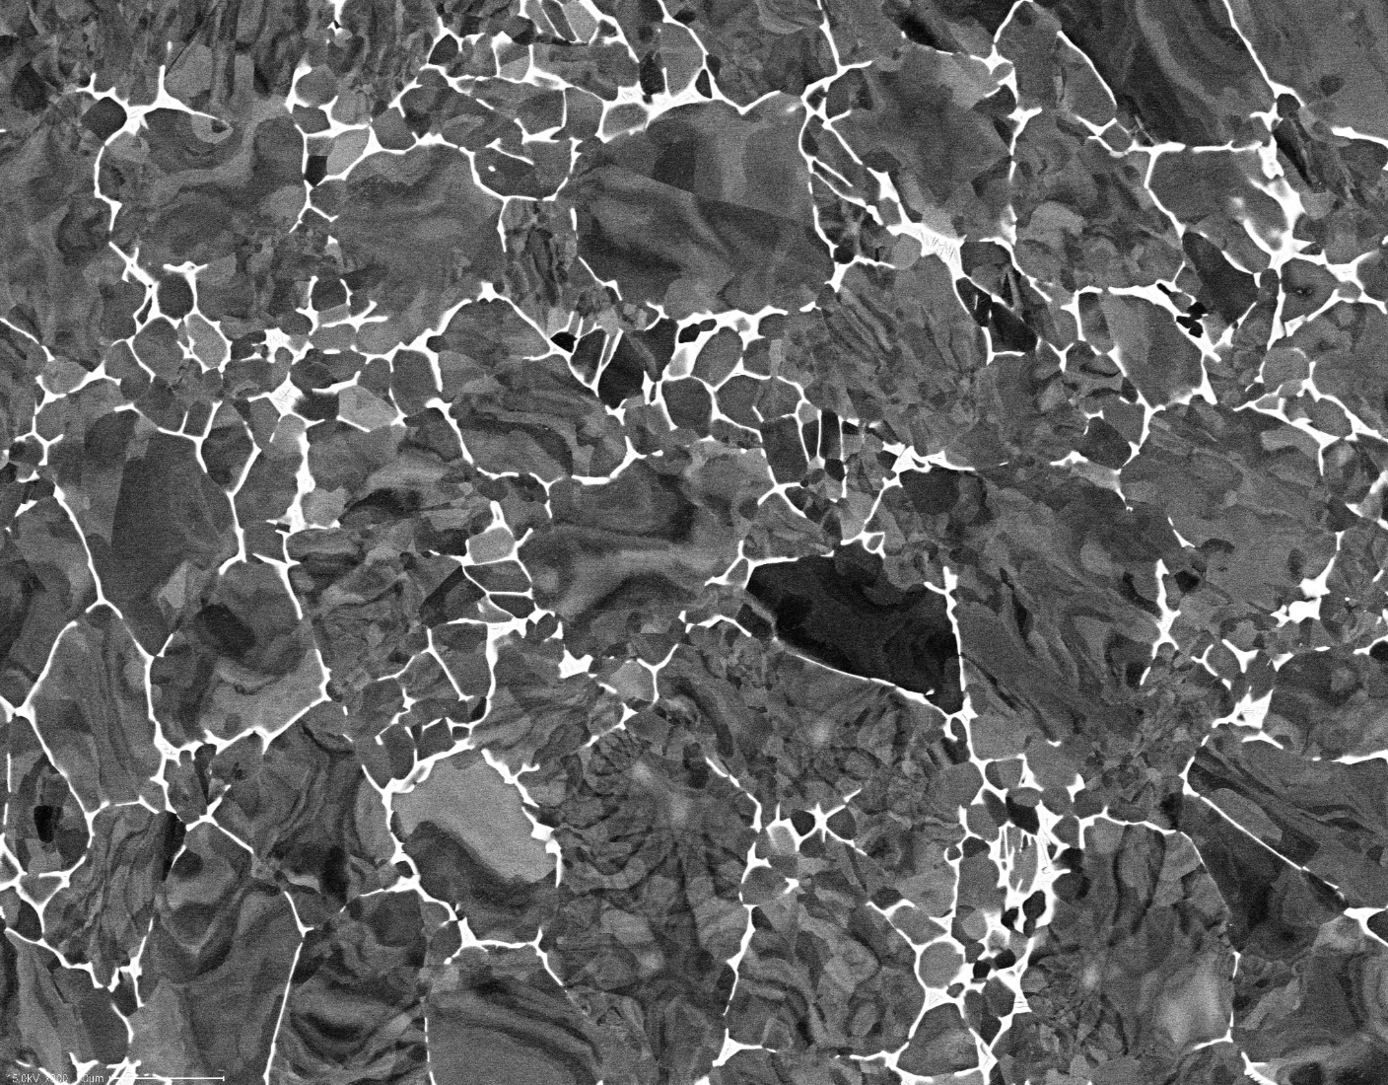
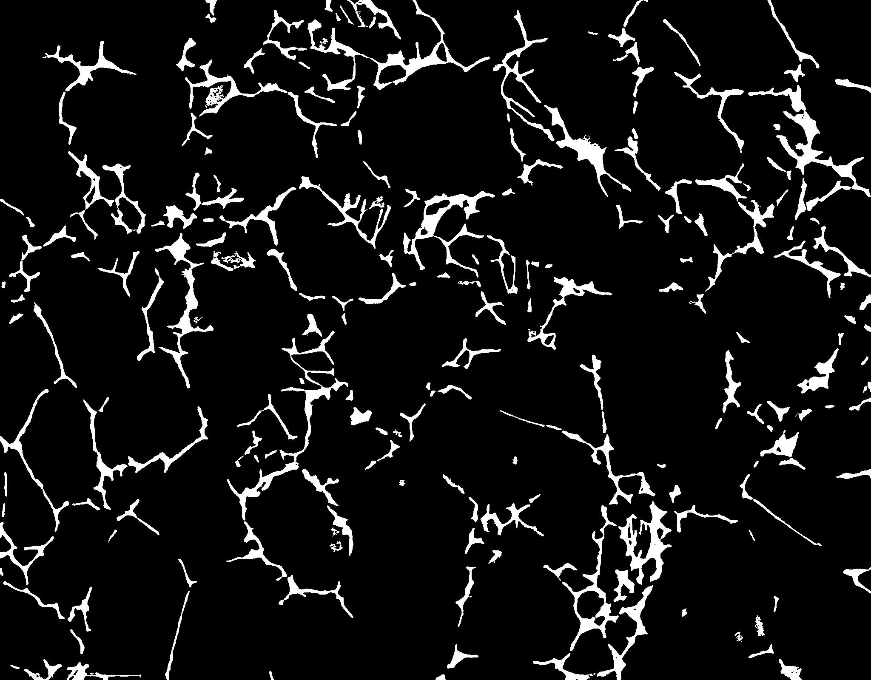
Volume fraction (%)
α | 91.82
β | 8.18

Slide 2
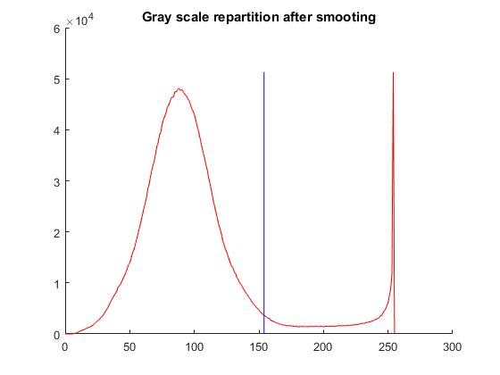
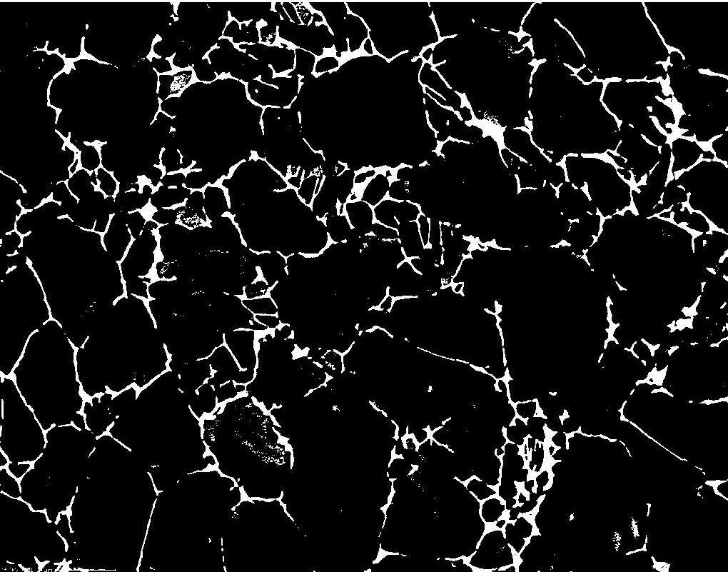
clear; close all;
fname = '850C1hAC_800x'
i = imread(sprintf('%s.tif',fname));
%% Gaussian smoothing
a = imgaussfilt(i,1);
%% graythresh: Global image threshold using Otsu's method
t = graythresh(a);
A = a>t*255;
%% Remove small white dot (smaller than 100)
B = bwareaopen(A,100);
%% Save image as a tif file
imwrite(B,sprintf('%s_Segmented.tif',fname));

Slide 3
Volume fraction (%)
α | 91.82
β | 8.18

